Slide 1
How GIS is changing the World
Presented by: Kaushik Dey

Slide 2
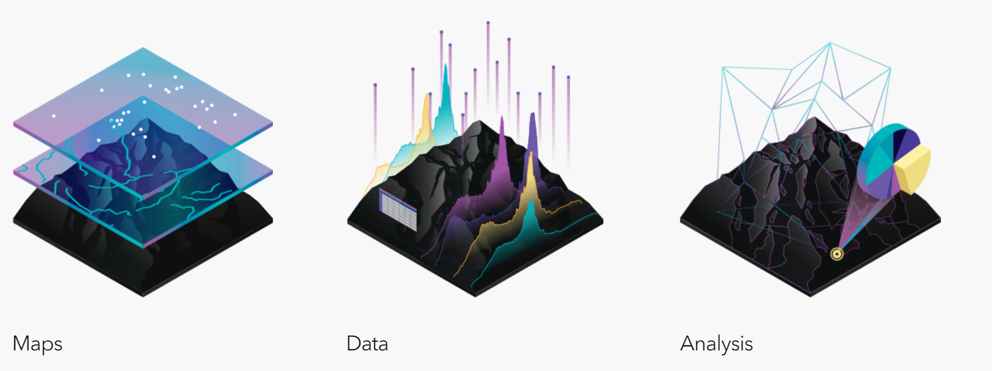
Introduction:
Geographic Information System (GIS) is a platform to create, manage, visualize and analyse geospatial data.
Source: https://www.esri.com/en-us/what-is-gis/overview

Slide 3
Maps are the geographic container for the data.
GIS integrates many different kinds of data layers using spatial location. Most data has a geographic component.
Spatial analysis are used to calculate/ evaluate/ estimate/ predict/ interpret to produce various output which gives new perspectives to the decision-making.
Let’s take a retrospective look from where concept of GIS has evolved

Slide 4
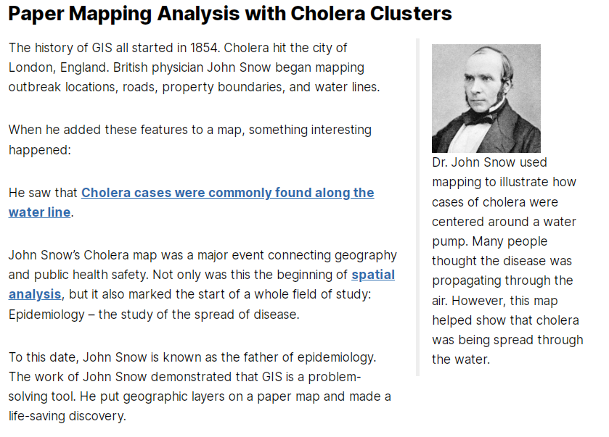
Source: https://gisgeography.com/history-of-gis/

Slide 5

How GIS is changing the World?
How GIS is changing with the World?

Slide 6
Transition:
Hard copy Map / Paper Map
Digital Map
Analog Photogrammetry
Digital Photogrammetry & Remote Sensing
2D contour/ hill shade
3D Digital Surface Model
Map Sales Counter
Web Map Service
Web Feature Service
File Database
Relational Database Management System
Desktop GIS
Distributed GIS

Slide 7
GIS is a combination of several technologies/subjects
GIS is not a standalone platform rather it is a combination.
Geography, Mathematics, Surveying and Mapping, Computer Programming, Networking, Computerized map making, Database Management System(DBMS) etc. all these fields have crucial role in the evolution of GIS. Major advancement mainly in the field of Computer science has transformed GIS from a mere concept to a complete platform.

Slide 8
Changing GIS with Changing World
Where the concept began with Hard copy map analysis but with the advent of Computer it has shown it’s enormous potential in almost every decision support system.
At early stage functionality of GIS software and tools were confined within standalone computers.
Necessity and availability of technology made it possible to grow GIS from standalone mode to a Distributed GI Service where Data, Applications and Users are distributed all over the world.

Slide 9
Changing GIS with Changing World
Today an user sitting at any corner of the world has the flexibility to access GIS application interface where analysis tools, map layers, data layers all coming from different geographic location but still allowing the user to perform GIS analysis and generate output.
Now it is possible to carry out enterprise level GIS work using thin client, thanks to cloud computing.
At present Location based service (LBS) is a need of the hour.

Slide 10
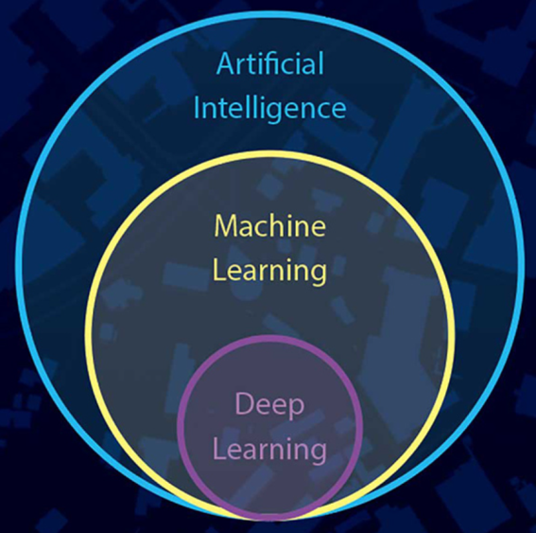
Changing GIS with Changing World
Location intelligence (LI), or spatial intelligence, to measure optimal locations for operating a business or providing a service or crime prediction.
Source: https://en.wikipedia.org/wiki/Location_intelligence
Use of Machine Learning(ML) and Deep Learning(DL) in GIS / AI driven GIS

Slide 11
Changing GIS with Changing World
Accuracy/precision of GIS analysis is primarily dependent on accuracy of input data. AI driven model has the capability to emulate human brain. Such models are used to process large data sets to bring out patterns which may not be possible by simple data visualization or may be extremely tedious and time consuming.
Artificial intelligence has improved the predictive capability of spatial modelling techniques

Slide 12
Changing GIS with Changing World
Supervised and unsupervised classification of Image
Auto feature extraction
Finding best possible rout based on many real time parameters like traffic condition, road condition etc.
Decision making to control spread of disease based on demographic data.
Decision support in Disaster management

Slide 13
In a Nut Shell
GIS is a game changer in the daily life of common people
In every field it is finding it’s business
GIS has the adaptive capacity to grow with technology, use the power of new technology. This evolving capacity of GIS is making it more sustainable and more relevant day by day.

Slide 14
Thank You

